Slide 1
SmartCAD Advisory Board Meeting, 2016
SmartCAD:
Guiding Engineering Design with Science Simulation
Charles Xie
This work is supported by the National Science Foundation (NSF) under grant numbers 1348530 & 1503196. Any opinions, findings, and conclusions or recommendations expressed in this material, however, are those of the authors and do not necessarily reflect the views of the NSF.

Slide 2
What problems are we trying to solve?
Engineering design is a process. Summative assessment based on analyzing final products is too little too late. We want to help students while they are on it. Continuous formative feedback is a key. But it is impossible for teachers to keep track of every move of every student.
Fair analysis of complex design may also be too time-consuming as it needs to include many fine-grained, domain-specific aspects.
Computers can do all these on human’s behalf!
Common Approach
Coarse-Grained, Delayed Feedback
Learn/Review
Concept A
Construct & Revise
Products
Test & Evaluate
Products
Concept B
Concept C
New Approach
Fine-Grained, Real-Time Feedback
Notes:
This work concerns teaching engineering design.

Slide 3

The SmartCAD Vision
I
Students use CAD to
design solutions and generate data
II
Researchers use data mining to analyze learning
VPA
Database
Process data
Computer scientists translate
research findings into algorithms
Artificial Intelligence
Automatic feedback
III
Part I
Part II
Part III
Build design capacity
Develop data mining methods
Design automatic feedback

Slide 4
Part I
Building Design Capacity
to Support a Variety of Engineering Projects Related to Energy

Slide 5
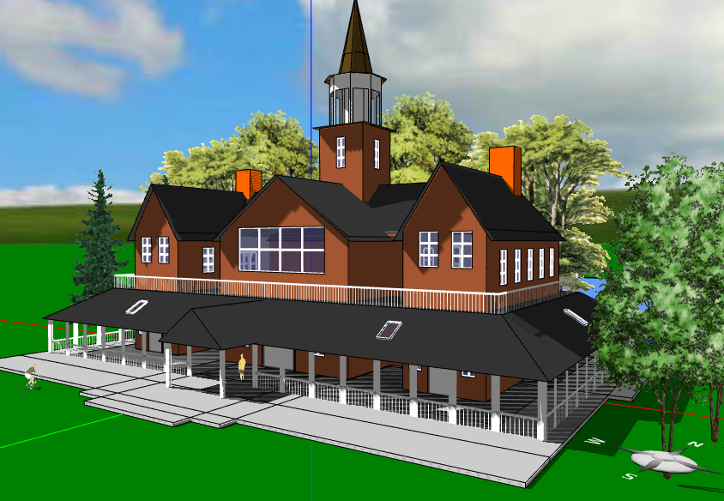
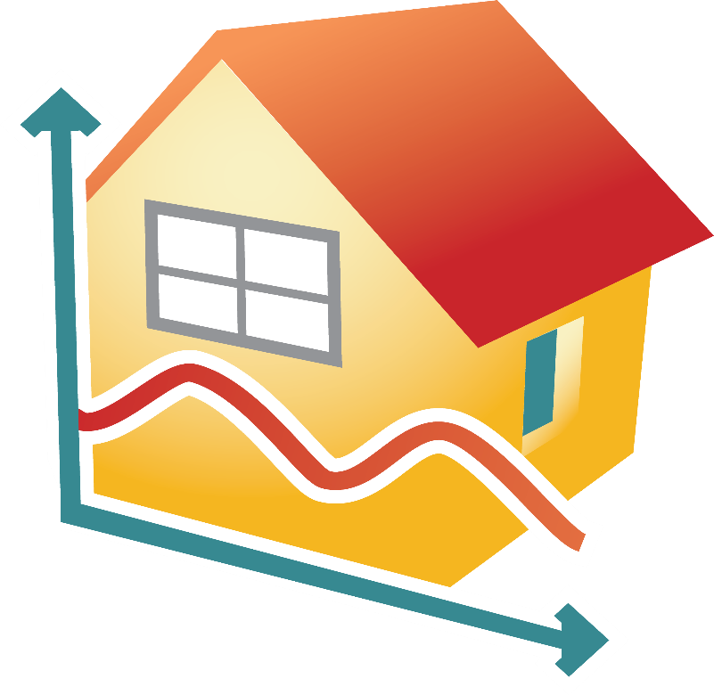
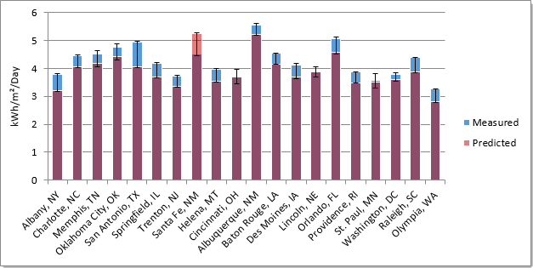
The Energy3D SmartCAD program:
A simulated engineering design environment
An open lab for anyone to conduct data-intensive research on engineering design
Architectural engineering
Solar engineering
Energy engineering
Urban planning
…
http://energy3d.concord.org

Slide 6
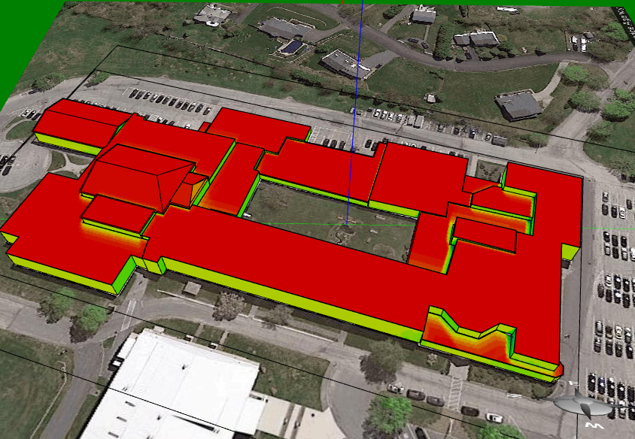
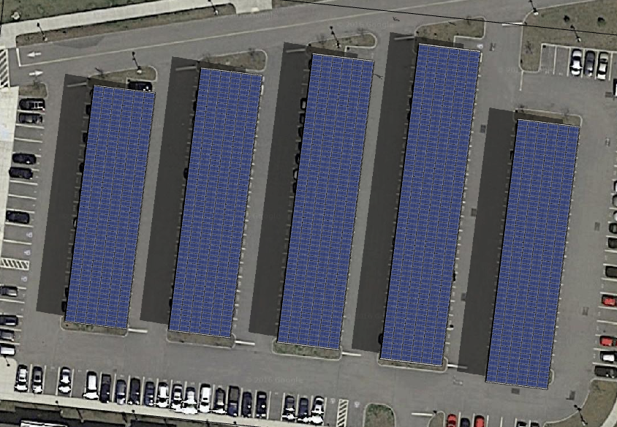
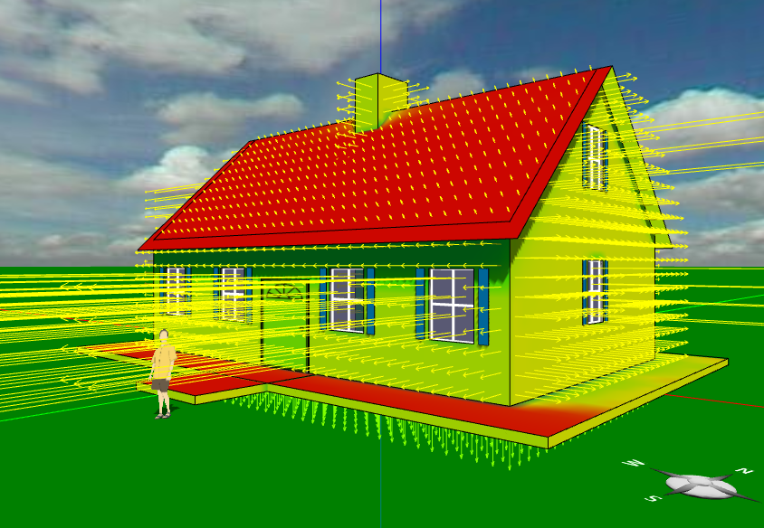
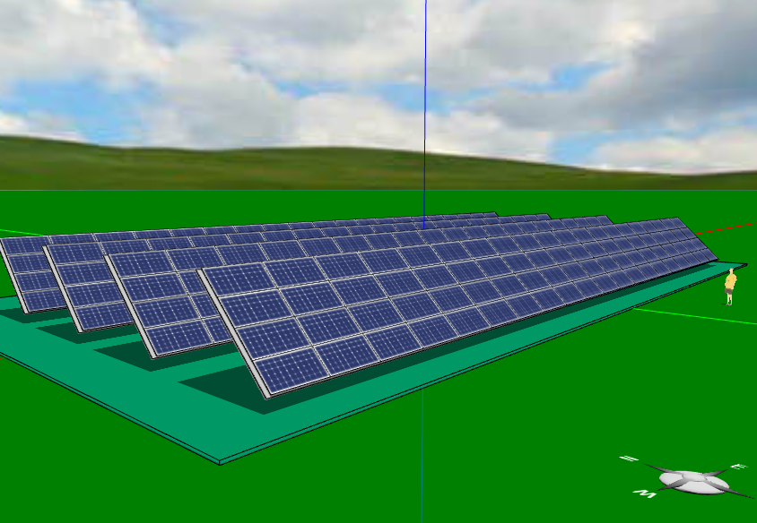
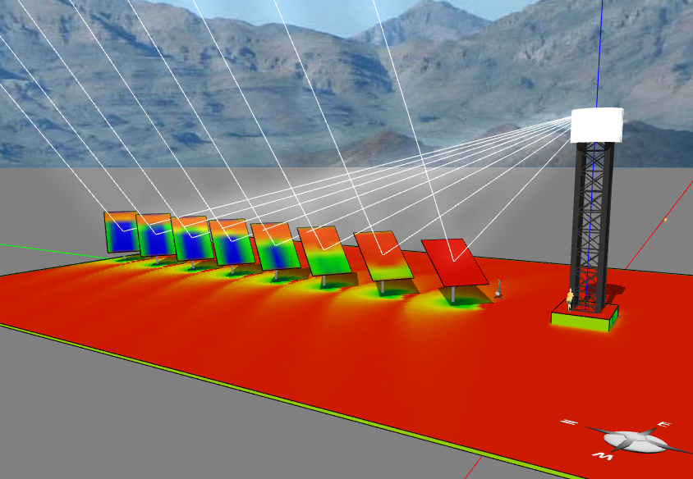
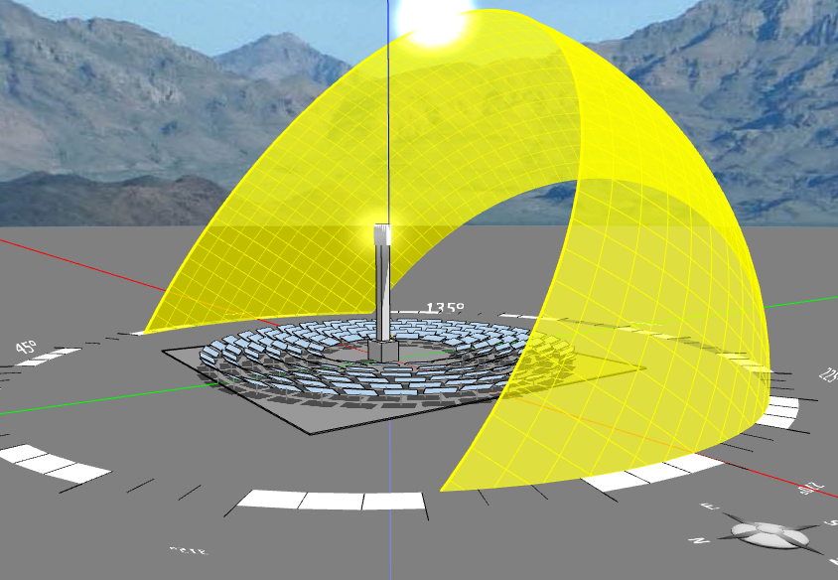
Design Capacity of Energy3D
There is no room for complacency in CAD as it must model reality accurately.
Environmental modeling
Google Maps integration
Weather datasets (NREL’s TMY, TMY3*)
Geothermal heat transfer
Solar modeling
Photovoltaics (PV)
Rooftop PV solar systems
Ground-mounted solar panel arrays
Solar canopies
Solar trackers (HSAT, VSAT, AADAT)
Concentrated solar power (CSP)
Solar power tower
Parabolic trough*
Compact linear Fresnel reflector*
Solar updraft tower*
Building modeling
Building envelope design
HVAC system
Passive solar
Landscape
Financial modeling
Cost-benefit analysis
Net metering
Community solar
* Under construction

Slide 7
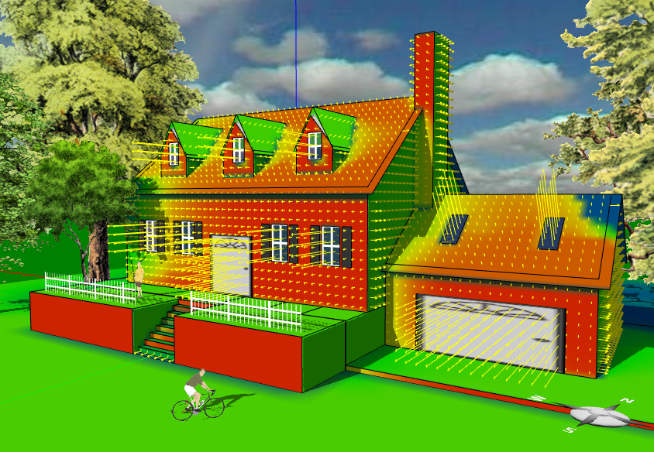
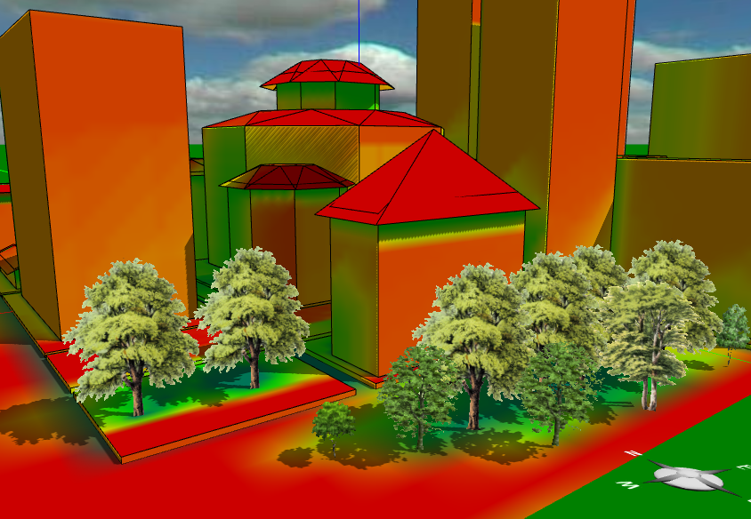
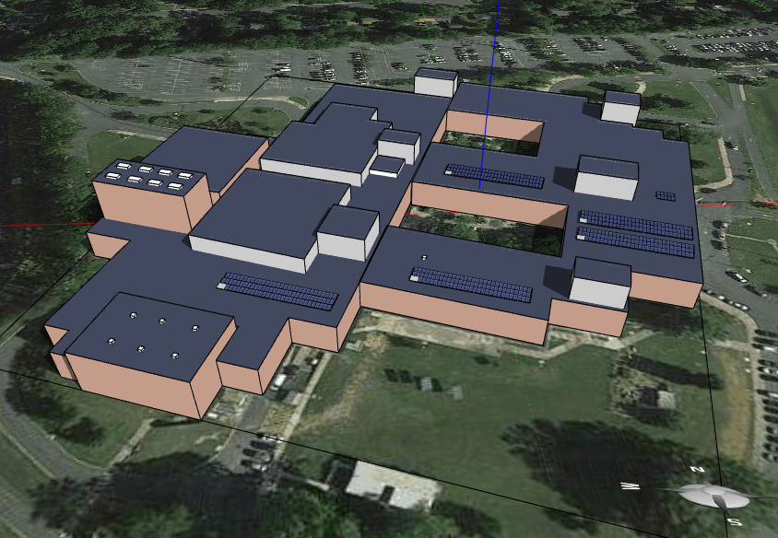
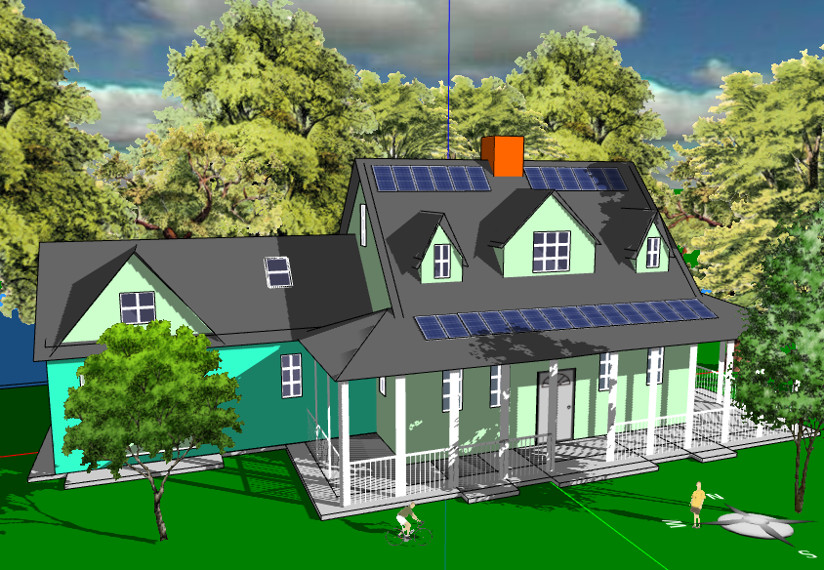
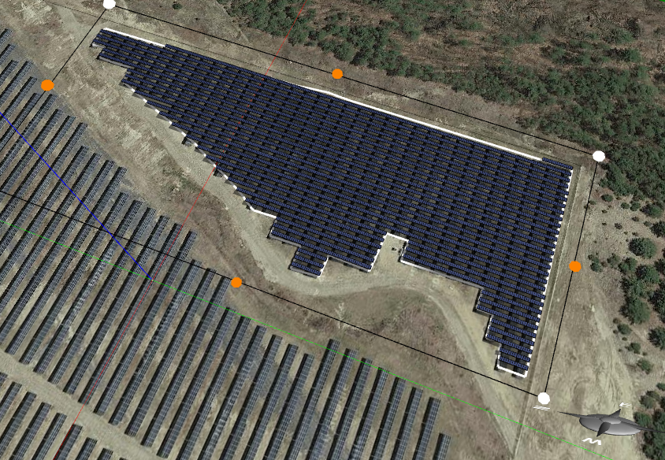
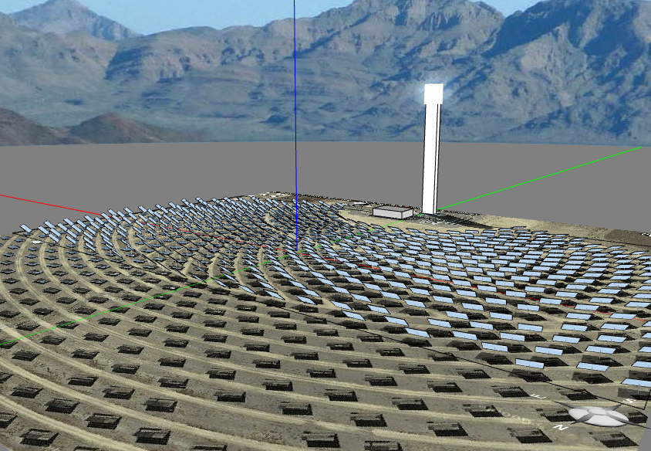
Engineering projects supported by Energy3D
Design an Energy-Plus Home
Design a home building that generates more renewable energy than it consumes over the course of a year
Design a City Block
Design a city block with high-rise buildings that have optimal solar access and minimal impacts on existing buildings
Solarize Your School
Design a solar power solution (e.g., rooftop solar panel arrays or solar canopies over parking lots for your school
Solarize Your House
Design solar panel arrays for your house that has the best cost effectiveness
Design a Solar Farm
Design a solar farm for a brownfield or landfill in your town
Design a Solar Power Tower
Design a utility-scale concentrated solar power plant

Slide 8
Part II
Building Data Mining Capacity
to Support Computational Analysis of Student Design

Slide 9
What data do we mine?
Category I: Artifact mining
Data sources are results from analyses/simulations/virtual tests of designs based on geometric, physical, and financial modeling.
Category II: Action mining
Data sources are actions that lead to changes of artifacts or not (e.g., an analysis informs design but does not change the solution per se).
A breakdown of engineering design process
(intertwined sequences of actions and artifact changes)
Artifact
Action
Action
Action
Artifact
Action
Time

Slide 10
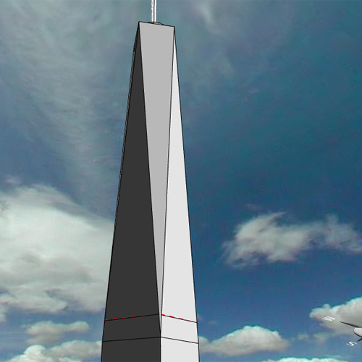
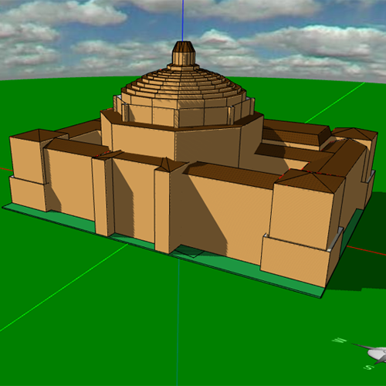
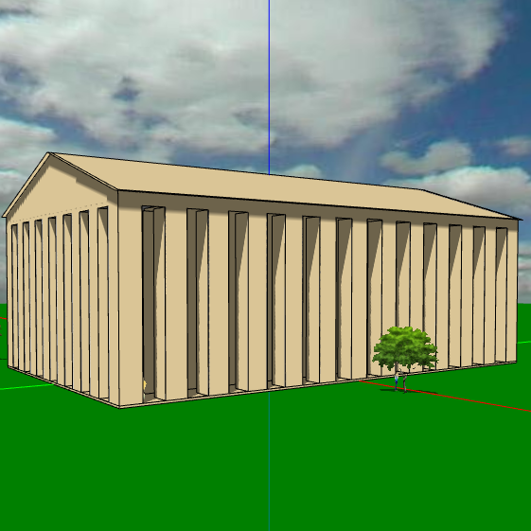
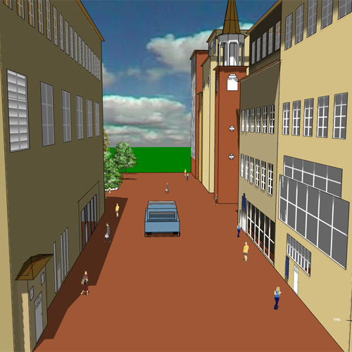
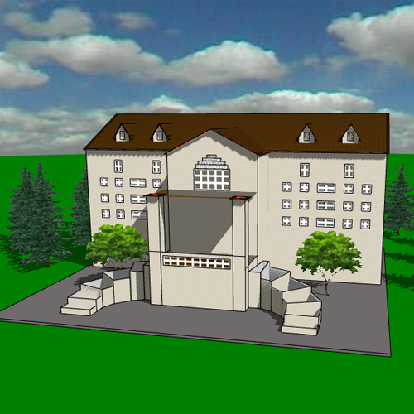

Collecting empirical “atomic” process data
Students design models that work in cyberspace. A logger collects their process data behind the scenes.
Outcomes (e.g., pre/post differences)
Pre-Test Data
Process Data
Post-Test Data
Explain
Process Mining
Energy3D “stealthily” logs “atomically” fine-grained process data about what students do.
“Stealth” Process Data Logger
Capture a construction event (add, remove, etc.)
Capture a simulation event and record its results
Track changes of an artifact property (size, etc.)
Track changes in a design note
Generate snapshot states of design
Our invention: A data logger based on Undo Manager and Track Change (more structured than mouse clicks)
CAD
Time

Slide 11
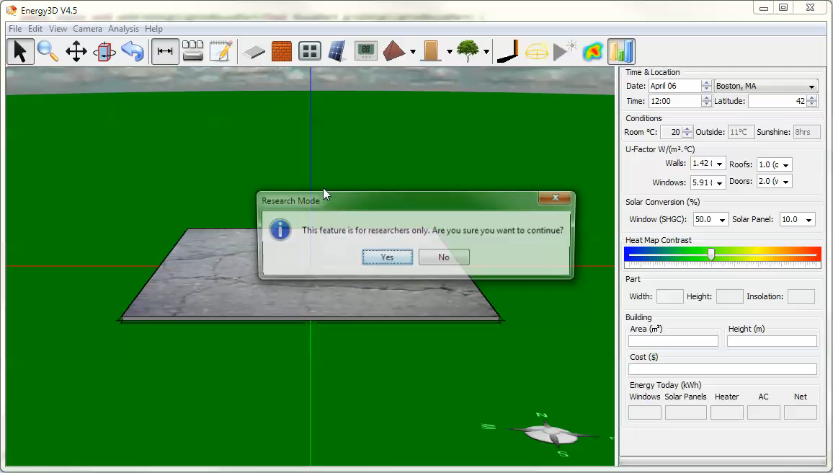
Design replay
Reconstruct a design process from the data log and play it back like running a slide show and post-process it to extract information as needed
(Embedded video)
Compare with screencast, recording is based on events, not lapse of time.
(i.e., no event, no record.)
High ratio of lossless compression!

Slide 12
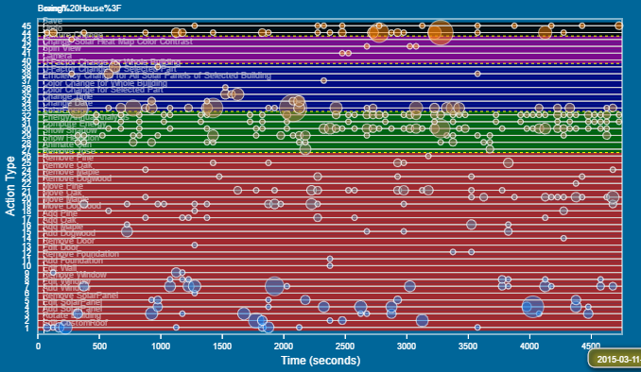
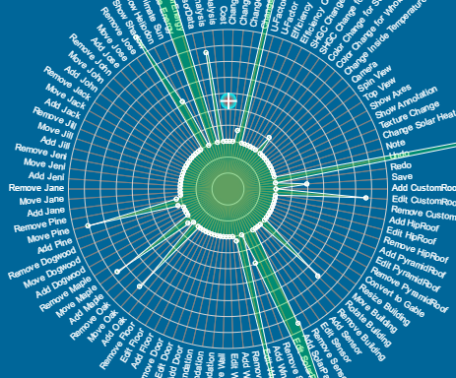
Data-intensive research
(aka “big data” – the fourth paradigm of science)
4,000-6,000 actions
300-500 snapshots
500-1,000 words
per student per project
How big will our data be?
3,000
Population dimension
3,000 students
20,000 hours
60 gigabytes
1
High-dimensional design space entails high-dimensional data
1
2
3
4
5
6
7
8
Hours
Time dimension
As of 2016: 1,000+ students’ data will be in our repository.
What can we do with these data?
What can we find from these data?

Slide 13
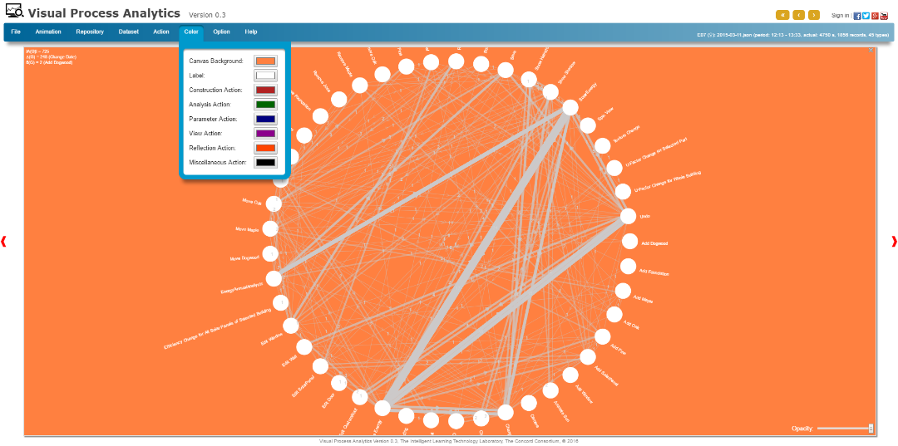
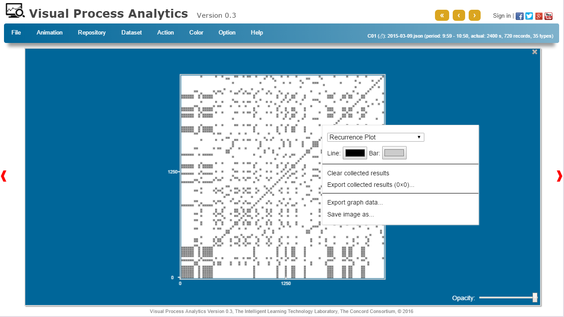
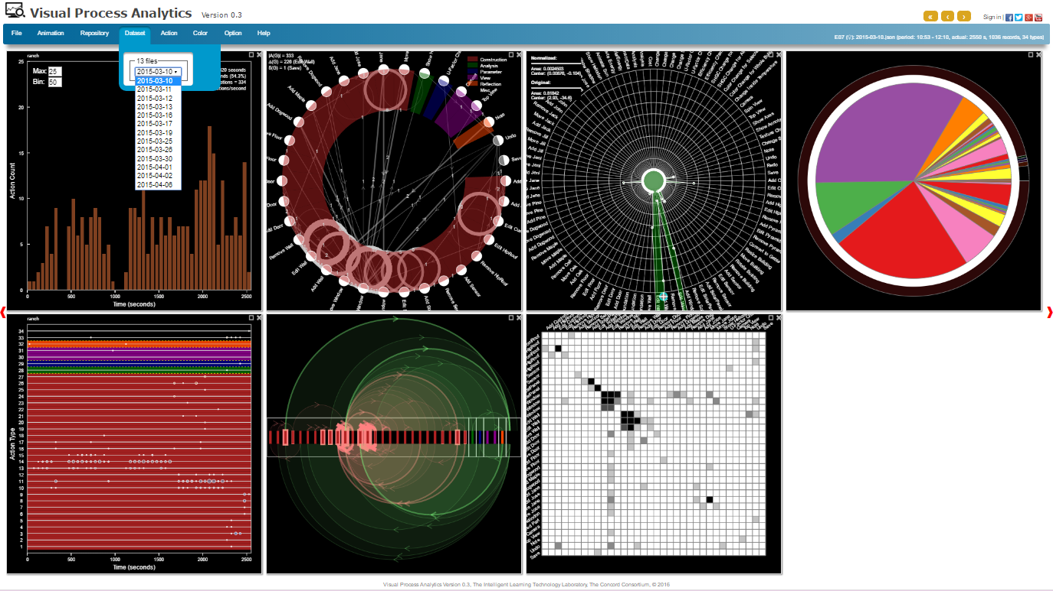
Visual Process Analytics (VPA)
Let’s start with visualizing the data.
VPA is a cloud-based data mining platform that supports research on
student learning through using complex tools to solve complex problems.
http://vpa.concord.org
Process mining
Process modeling
Process discovery
Conformance analysis
Statistical analysis
……
VPA
Data Structures
Visualizations
Interactions
Algorithms
Models
Management

Slide 14
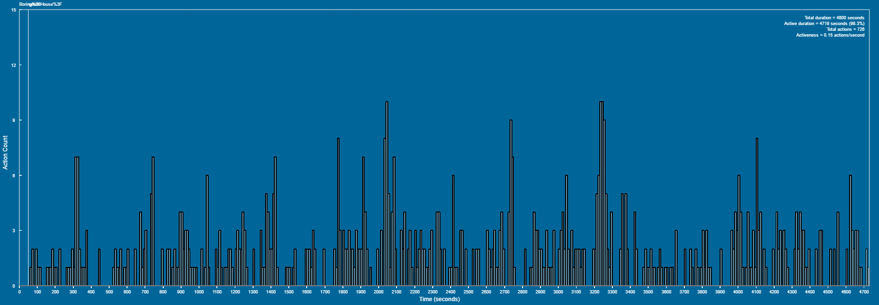
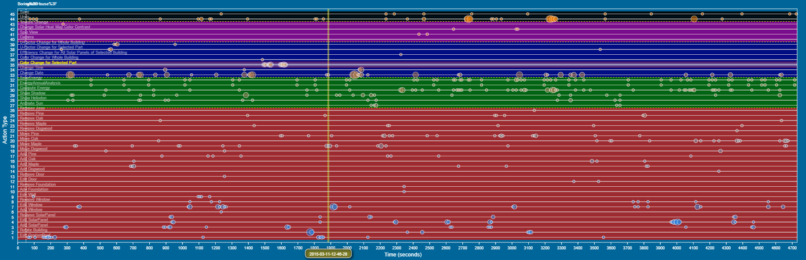
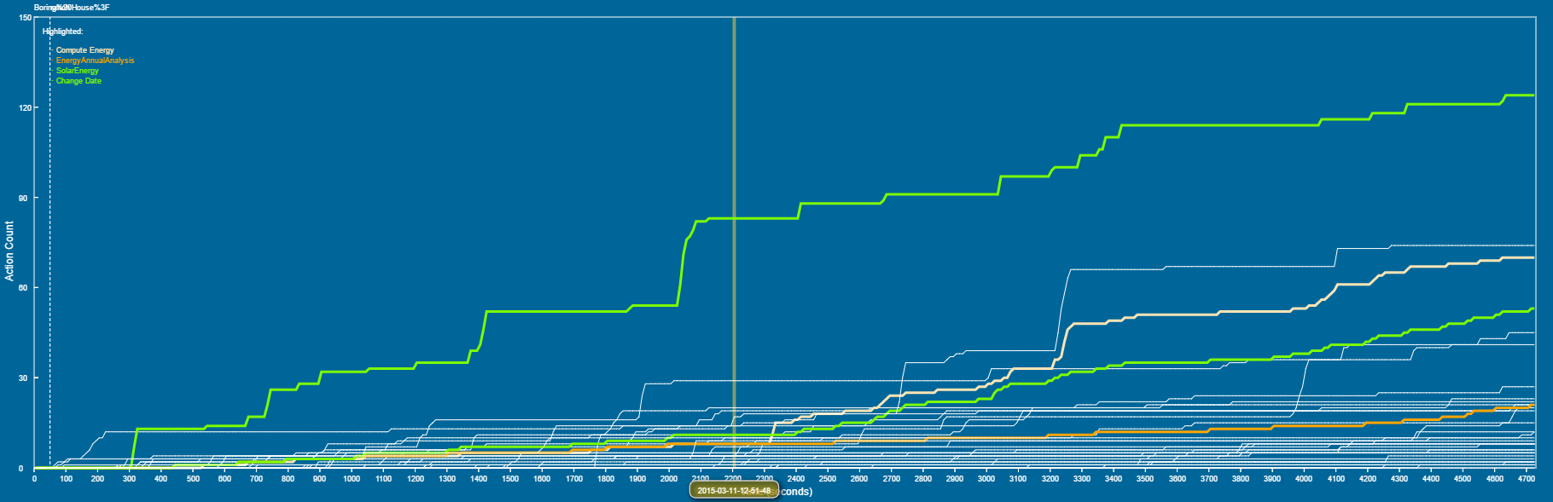
VPA supports multiple representations of data
Time series visualization
Histogram shows the total number of actions within each time bin
Scatter plot shows the number of actions of different types within each time bin
Cumulative graph shows the growth of the total number of actions of different types
Each kind of visualization represents a different view of the data and a different aspect of the process.
Histogram
Scatter plot
Cumulative graph

Slide 15
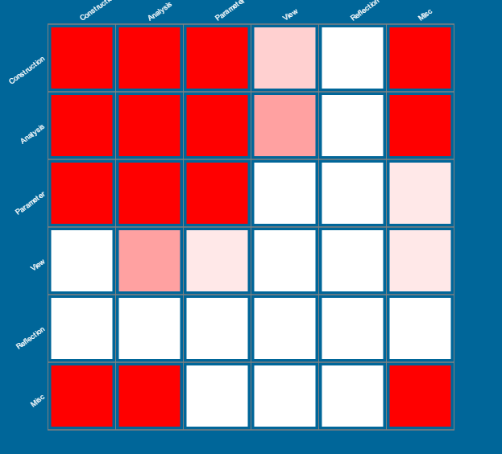
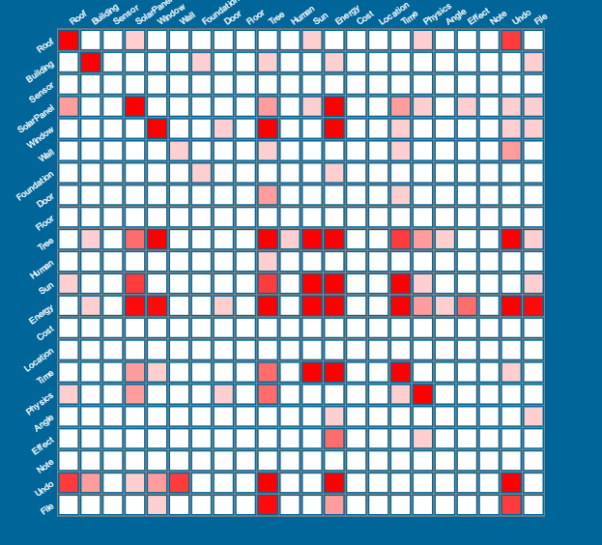
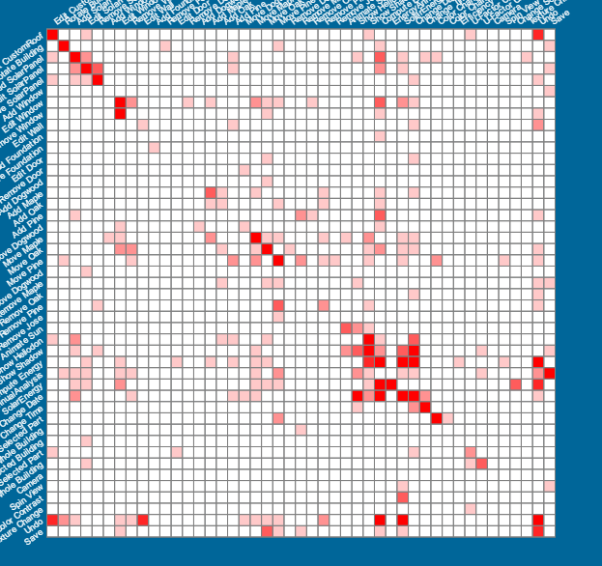
VPA supports multiple granularity of visualization
Coarse-grained vs. fine-grained analysis across knowledge graphs
Project
Part of an approximate multi-level knowledge graph
of an energy-plus home design project
Top
Construction
Analysis
Medium
……
……
Roof
Solar Panel
Cost
Sun
Fine
Add
Remove
Change
Add
Remove
Change
……
Items
Categories
Shadow
Heliodon
Diurnal
……
Heat maps of task transitions (to be described later)

Slide 16
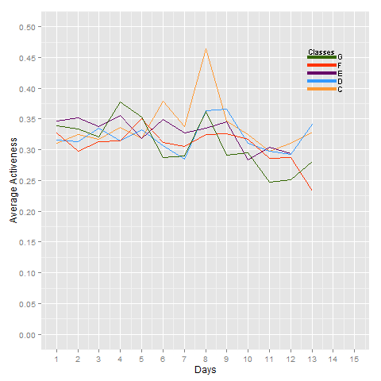
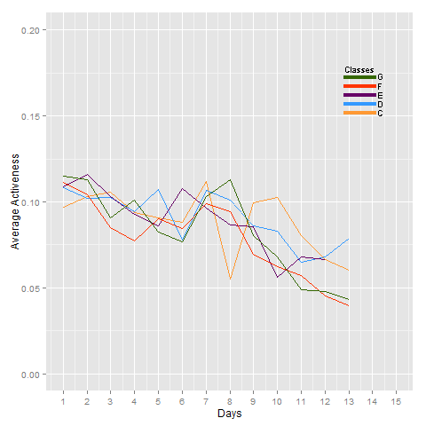
VPA supports data collection and export
Mined results can be collected and exported for further analyses.
The change of the average activeness of five classes of students over time
(a total of 110 students)
The change of average activeness of five classes of students after
filtering out 3D rotation and note taking, showing a gradual decrease over the course of two weeks.
Excel
RStudio

Slide 17
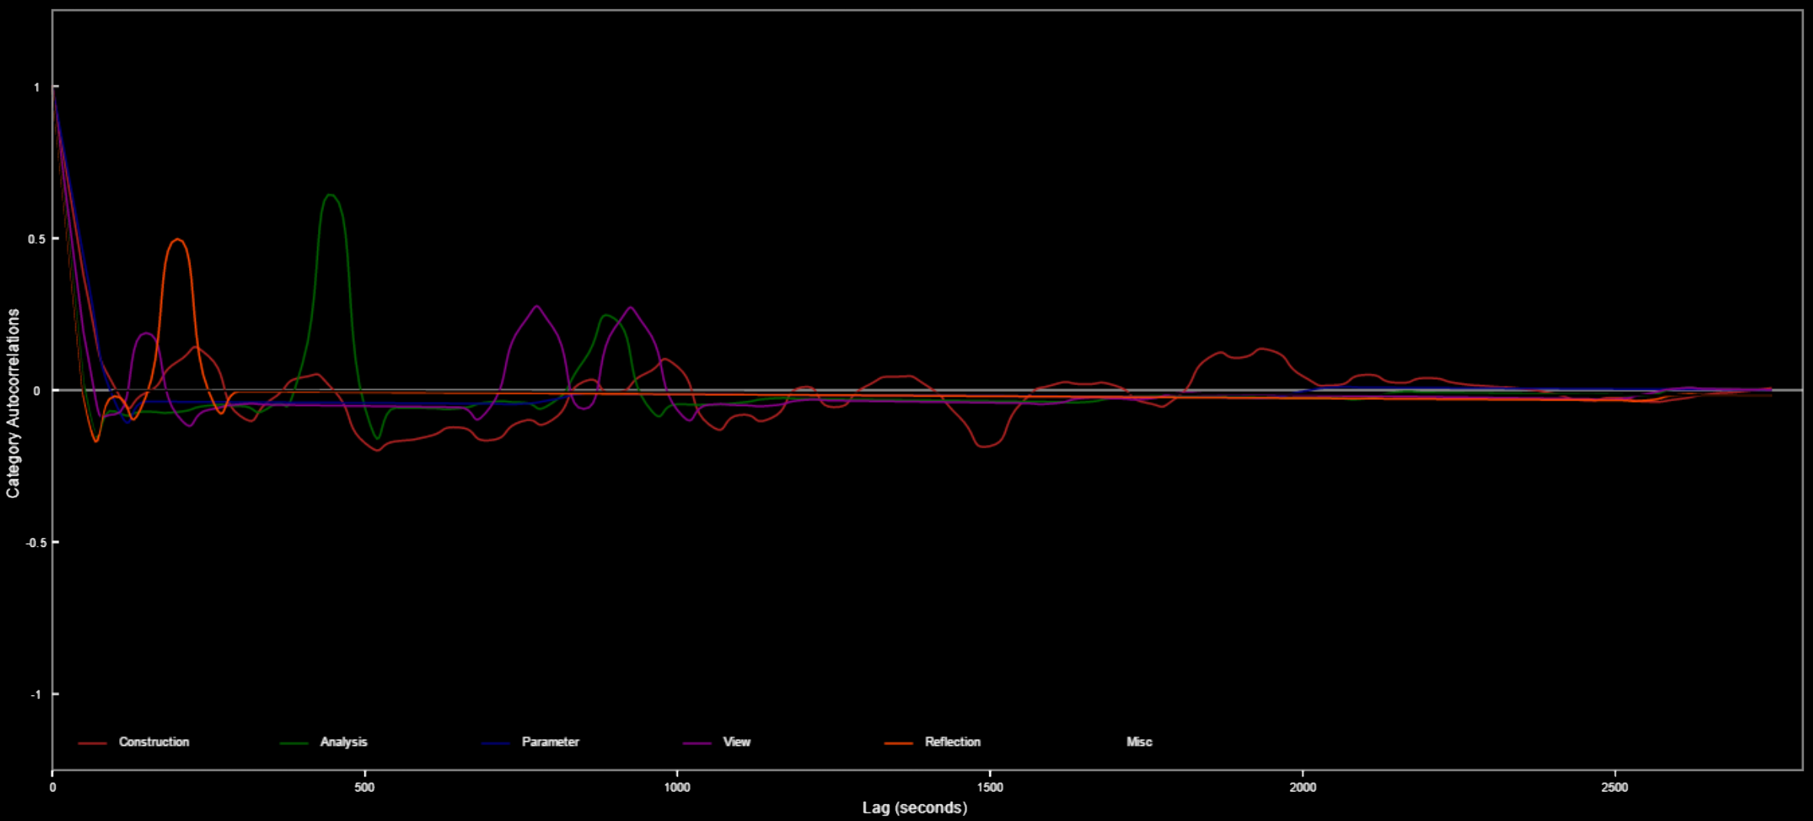
VPA tool: Time correlation functions
Correlograms show repeating patterns of behavior: After how long, on average, do students repeat certain types of actions (an indicator of possible design iteration)?
Construction (~200s), analysis (~450s)

Slide 18
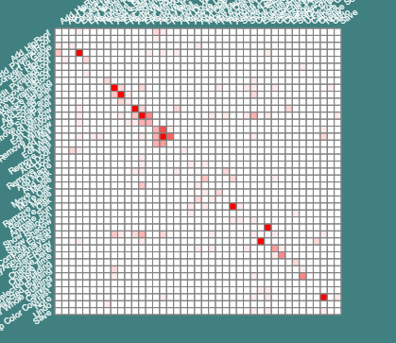
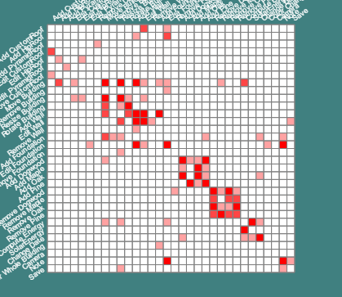
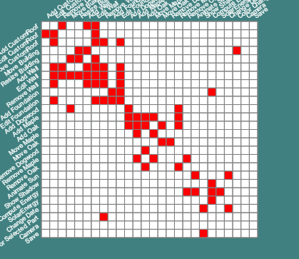
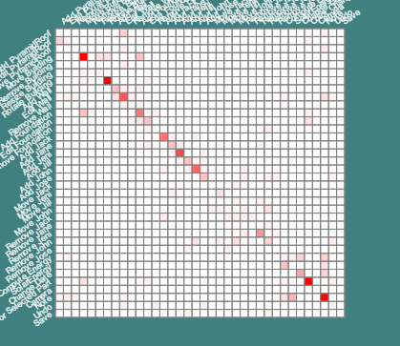
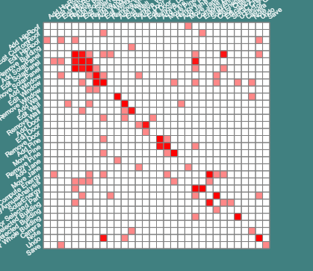
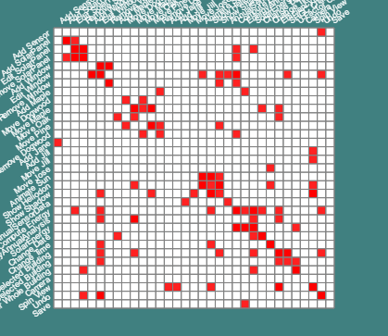
VPA tool: Heat map of task transitions
Transitions from tasks to tasks may reflect how students use the CAD tool to solve a design challenge.
Few transitions
Localized transitions
Frequent transitions
* This kind of heat map is a visual representation of the adjacency matrix of a design graph.

Slide 19
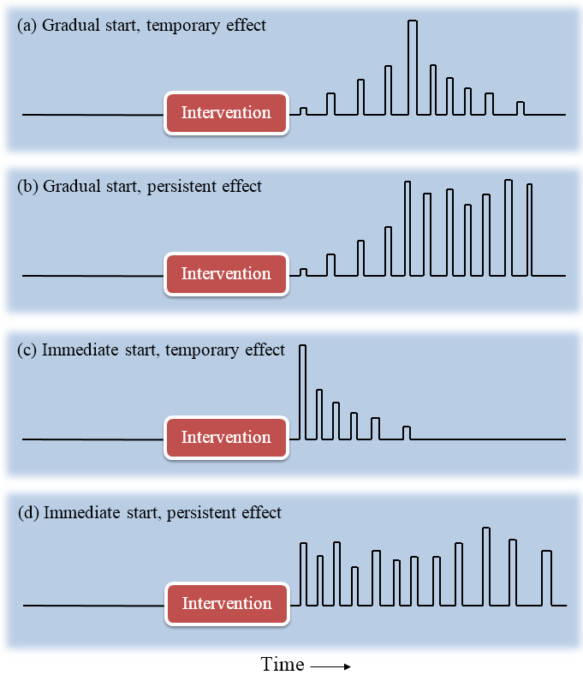
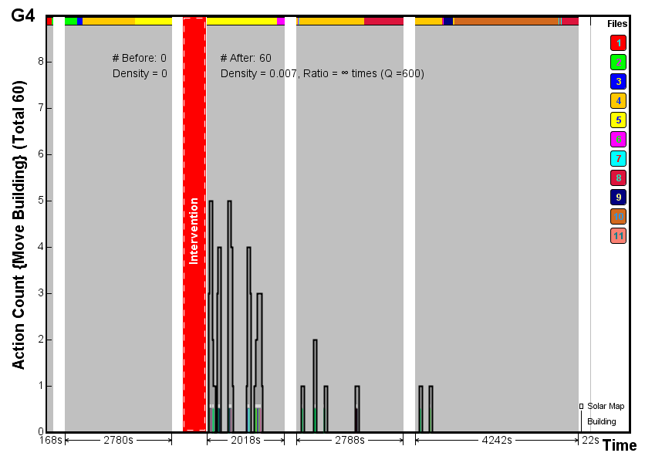
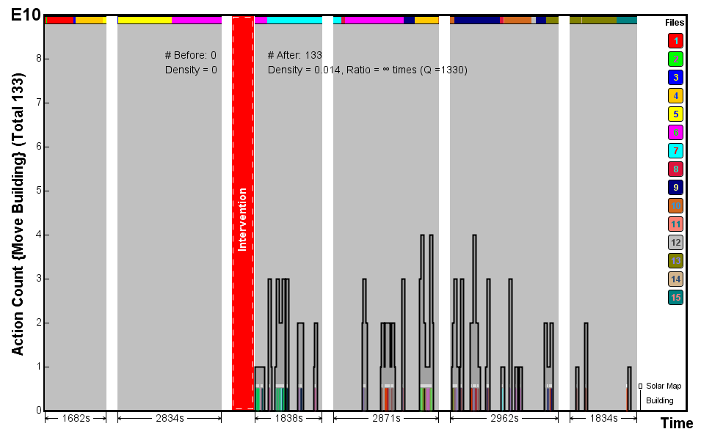
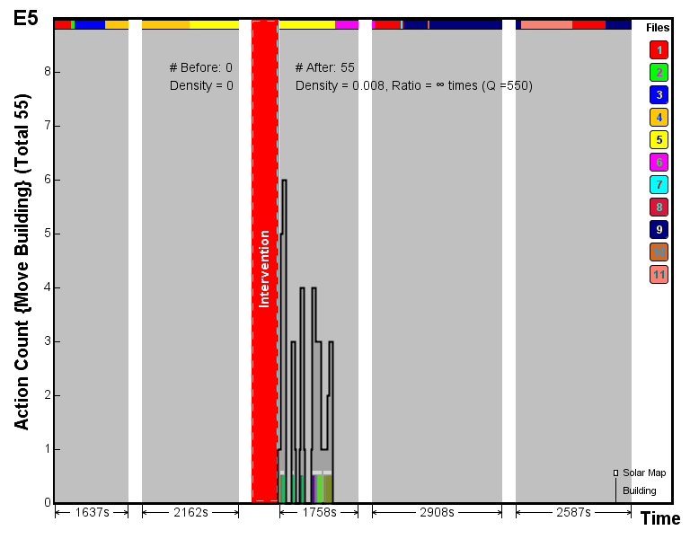
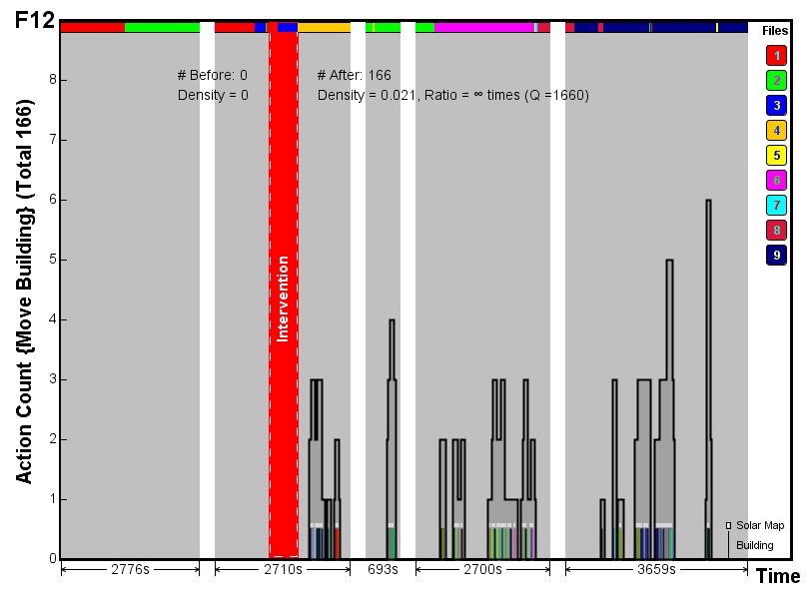
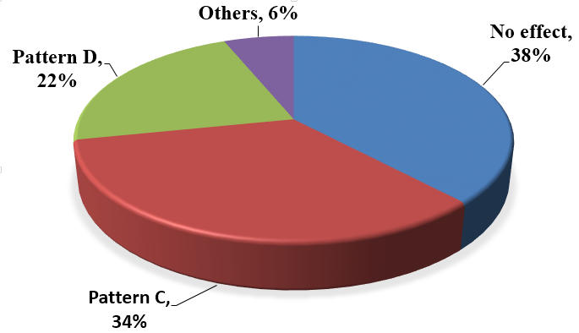
VPA tool: Response functions
How do students respond to an intervention?
(An intervention can be computer-generated feedback, teacher instruction, or student discussion.)
The distribution of response patterns of 65 students
Pattern C: Decay
Pattern D: Persistent

Slide 20
Part III
Develop Automatic Feedback
to Guide Student through Complex Engineering Design
Input
System
Output
Feedback

Slide 21


The position of feedback in learning
SmartCAD is integrated with curriculum units that specify the design specifications and provide instructional scaffolding. Feedback provides an additional driving force for learning.
Push:
Formative feedback
Pull:
Curricular scaffolding
Learning

Slide 22
What are the differences between SmartCAD and conventional analysis in CAD?
Feedback is based on studying the designer, the design, and the CAD tool as a whole system (i.e., human is a variable in the system).
 | Conventional CAD Analysis | SmartCAD Feedback
Subject of study | Product | Product + Designer
Engagement of user | Passive | Active
Criteria of success | Meeting design specs | Meeting design specs and learning STEM

Slide 23
Representations of feedback
Feedback communicates suggestive multimedia to students
SmartCAD
Produce
Data
Voice
Text
Visualization
Animation
Multimedia
Graph
Chart
Heat Map
Definitive feedback: when the data suggests clear instruction
Interpretive feedback: when the data needs interpretation (e.g., reading a graph)
The system can’t interpret the data if it is not “smart” enough or the data is too complex. One way to think about our research is to increase data mining capacity (e.g., feature extraction) so that feedback can be more definitive.

Slide 24
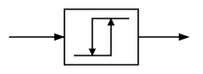
Feedback based on artifact mining
Input
Design Artifact
Simulation Test
Output
Feedback
Goal-directed feedback
Goal types | Examples | Drivers
Explicitly bounded by specifications | Design a net-zero house that consumes less energy than it generates | Total net energy
 | Design a house that costs no more than $200,000 to build | Total cost
Implicitly bounded by constraints | Design a solar park that generates as much electricity as possible | Total energy output
 | Design a city block that has fair sunlight access for every building | Fairness score
An example feedback model for explicitly-bounded goals: Bang-bang control
Goal line
Score
Score higher than goal line: OFF
Score lower than goal line: ON
Time

Slide 25
Challenges in creating feedback in design
Feedback is meant to modify designer behavior, but what aspect of the behavior?
(Behavior is defined by a sequence of actions.)
Case I: Only one action occurs before testing the design, changing only one output
Action X
Design Artifact
Output A
Case II: Multiple actions occur before testing the design, changing only one output
Action X
Action Y
Design Artifact
Output A
Action Z

Slide 26
Challenges in creating feedback in design
How should SmartCAD respond to the user’s actions?
Case III: Only one action occurs before testing the design, changing multiple outputs
Output A
Action X
Design Artifact
Output B
Case IV: Multiple actions occur before testing the design, changing multiple outputs
Action X
Output A
Action Y
Design Artifact
Output B
Action Z

Slide 27
Feedback based on action mining
Analytics
Output
Action
Designer Behavior
Feedback
Types | Examples | Drivers
Action monitor | Detect whether action X has occurred. If X is required, feedback should instruct the designer to take action X. | Action counter
 | Determine the effect of feedback by checking if an expected action has followed the instruction within a given period. | Action counter
Relation monitor | Actions {X₁, X₂, …, X_{n}} must all happen in order to solve a problem. | Correlation function
 | Actions {X₁, X₂, …, X_{n}} must happen in a given sequence in order to solve a problem. | Sequence pattern

Slide 28
Context awareness
Determine the timing for giving feedback
Input
System
Output
Context appropriate?
Yes
Feedback
No
Skip
Example of contexts
If a building is still under construction, don’t provide feedback to its performance.
If the designer has been working on solar panels, provide feedback related to solar panels.

Slide 29
Thank you
for your time!

